Slide 1
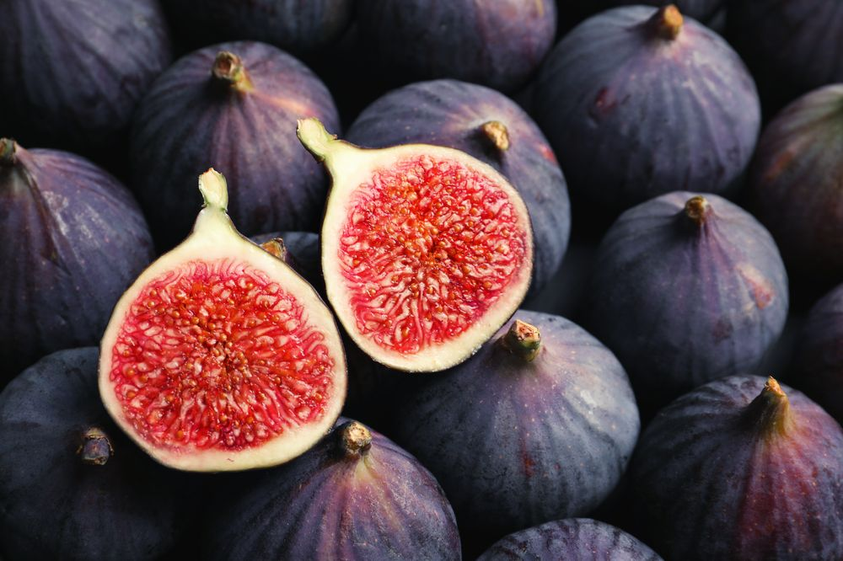
The fig is the edible fruit of ficus carica a species of small tree in the flowerling plant family Moraceae native to the meditreeanean region together with western and southern asia. It has been cultivated sice ancient time and is now widely grown throughout the world . Ficus carica is the type species of the genus ficus containing over 800 tropical and subtropical plant species.

Slide 2
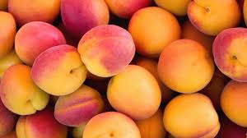
An apricot is a fruit or the tree that bears the fruit of several species in the genus prunus usually an apricot is form the species in prunus sect. Armeniaca are also called apricots. Rich in vitamin A, beta-carotene and other carotenoids apricots are excellent retina and lens health while caroteneds and vitamin E support overall vision. Apricot nutreients also help to reduce the risk of macular degeneration and cataracts.

Slide 3
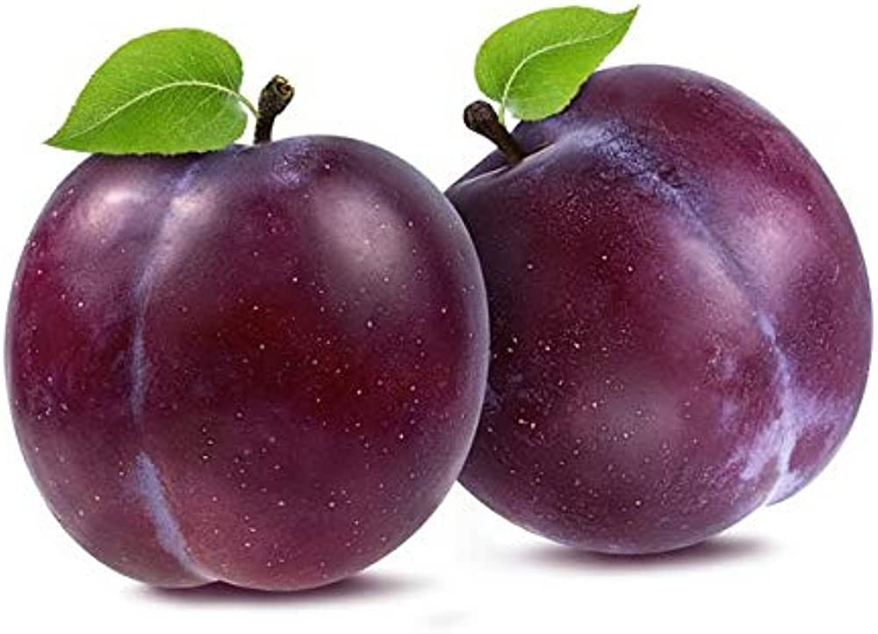
A plum is a fruit of some species in prunus subg. Prunus. Dried p;ums are most often called prunus, though after the year 2000 ijn the united states they may be just labled as dried plums. Plums may have been one of the first fruits domesticated by humans with origins in east europeanb and caucasian mountains and china. They were brought to britain from Asia and their cultivatuin has been documented in Andalusia southern spain. Plums are a diverse group of species with trees reaching a height of 5-6 metyers when pruned. The fruit is a drupe with a firm and juicy flesh.

